Slide 1
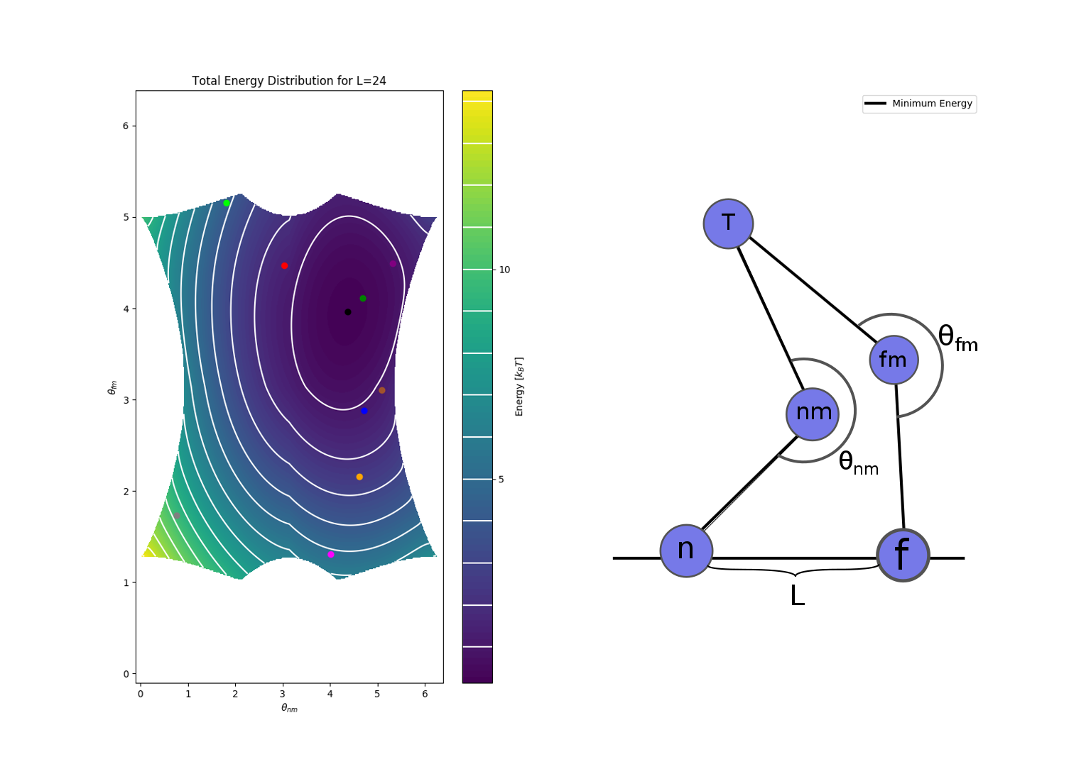
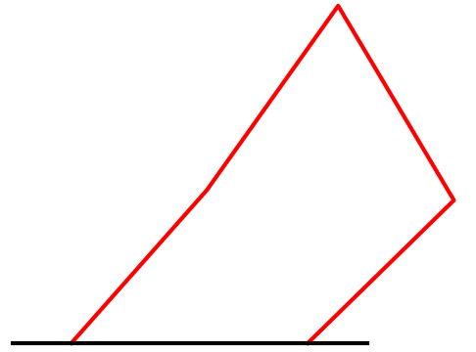
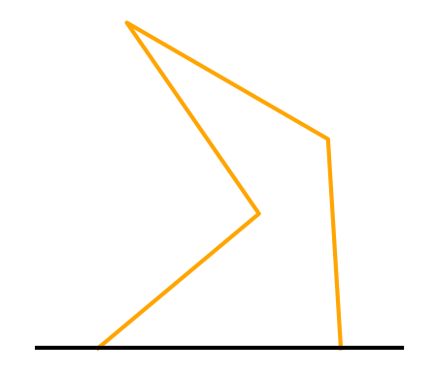
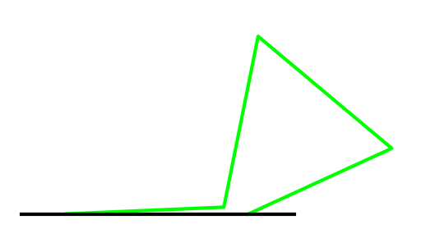
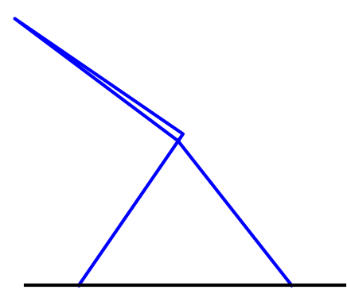
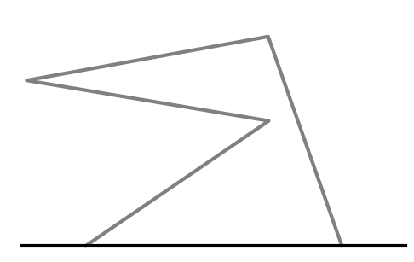
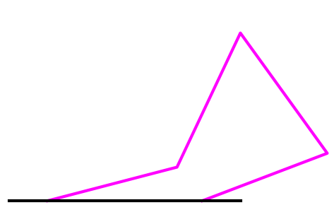
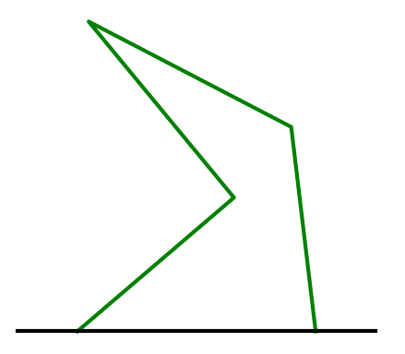
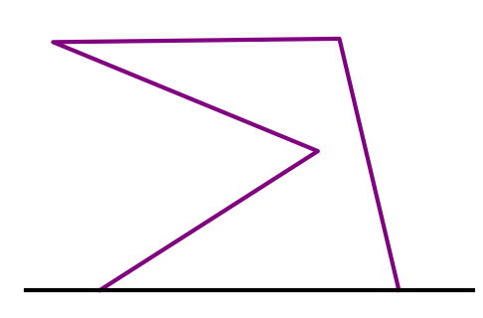
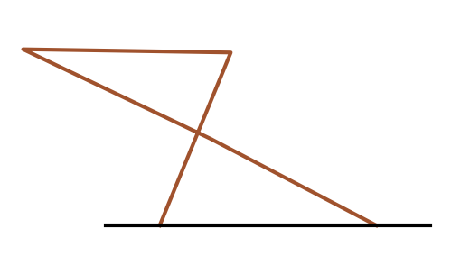
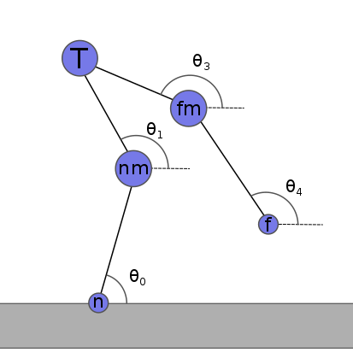
Simulating the Walk of the Dynein Motor Protein
Jin Kiatvongcharoen, John Waczak, Elliott Capek, and David Ruondy
Oregon State University
Motivation
Simulation
We aim to create a simple 2-D model of the motor protein dynein as it walks along the microtubule. The model will be simulated with Monte Carlo methods in order to replicate its random stepping behavior. The simulation’s goal is to display the mechanical nature of dynein and deepen our understanding on motor proteins.
Our model is separated into two states: both bound and one bound. They are both point-particle systems that involves one tail domain, two motor domains and two binding domains. We are able to create a configuration of dynein if two angles and an initial distance (L) are known.
Both Bound
Randomly pick
a set of
motor angles
Calculate
total energy
of the system
Determine
probability
of unbinding
Start one bound
simulation
if unbinding
is successful
Dynein
Dynein is one of the three motor proteins that are responsible for the cell’s ability to move, divide, and spatially organize itself. They convey cargo along a protein highway (microtubule) by using ATP to step. Its two feet can act independently from each other causing erratic and stochastic steps, allowing us to model its walk with Monte Carlo simulations.
Monte Carlo Method
Ad
One Bound
Brownian Motion
Collecting Data
We simulate the one bound state in a fluid, where random forces of the molecules against the domains causes diffusion for its ‘step’.
(I don’t think I should put more here but idk how to use this space)
After dynein takes a step, the final displacement of the landing foot and the time it took for the step would be recorded and the simulation would run again. This data would allow us to make histograms for various configurations of dynein.
Future Work
We hope to further improve and simplify our one bound simulation because of the complications that arises when the

